Slide 1
Artificial Neural Networks Data Preprocessing Hyperparmeters and Validation
Lei Qian, Ph.D.

Slide 2
Artificial Neurons - History
Invented by Warren McCulloch and Walter Pitts (called McCulloch-Pitts (MCP) neuron) in 1943.
The motivation is to simulate the activity of human neurons.
1962: Rosenblatt’s perceptron
Learned its own weight values; convergence proof
1969: Minsky & Papert book on perceptrons
Proved limitations of single-layer perceptron networks
1982: Hopfield and convergence in symmetric networks
Introduced energy-function concept
1986: Backpropagation of errors
Method for training multilayer networks

Slide 3
Artificial Neurons
2006: Jeff Hinton etc. developed a technique for training deep neural network.
2012: Alex Krizhevsky etc. developed AlexNet for image recognition.
2014: Ian Goodfellow invented Generative Adversarial Network (GAN).
2017: A group of researchers from Google invented Transformer Architecture (Attention Mechanism)
2022: OpenAI launched ChatGPT.

Slide 4
Axon
terminals
Myelin sheath
Input
Signals
Output
Signals
Dendrites
Axon
Cell nucleus
Schematic of a biological neuron.

Slide 5
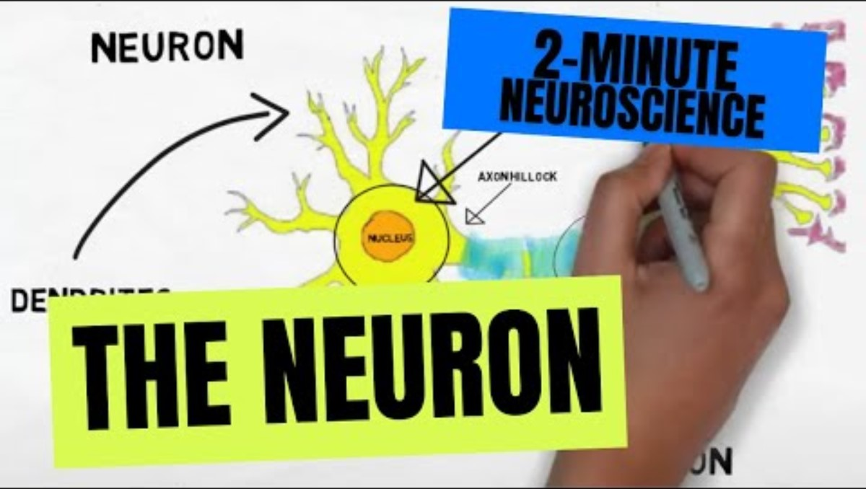

Slide 6
Artificial Neurons
1
Weight update
Error
w₀
x₁
w₁
Σ
Output
w₂
x₂
w_{m}
.
.
.
x_{m}
Schematic of a perceptron classifier.

Slide 7
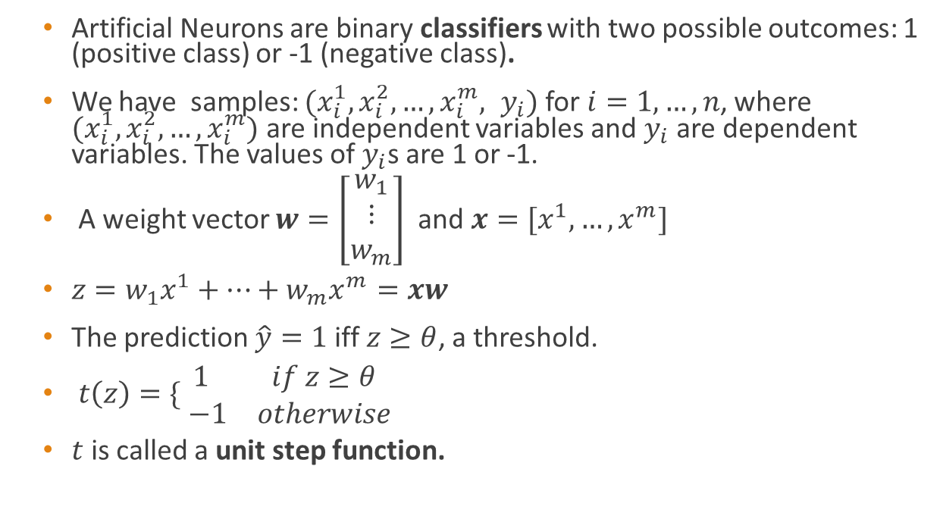
Artificial Neurons - Formal Definition
Artificial Neurons are binary classifiers with two possible outcomes: 1 (positive class) or -1 (negative class).
We have samples: $(x_{i}^{1}, x_{i}^{2}, …,x_{i}^{m}, y_{i})$ for $i=1, …,n$, where $(x_{i}^{1}, x_{i}^{2}, …,x_{i}^{m})$ are independent variables and $y_{i}$ are dependent variables. The values of $y_{i}$s are 1 or -1.
A weight vector $w=\left[\begin{matrix}w_{1} \\ ⋮ \\ w_{m}\end{matrix}\right]$ and $x=[x^{1},…,x^{m}]$
$z=w_{1}x^{1}+…+w_{m}x^{m}=xw$
The prediction $\hat{y}=1$ iff $z≥θ$, a threshold.
$t\left(z\right)=\{\begin{matrix}1 & if z≥θ \\ −1 & otherwise\end{matrix}$
$t$ is called a unit step function.

Slide 8
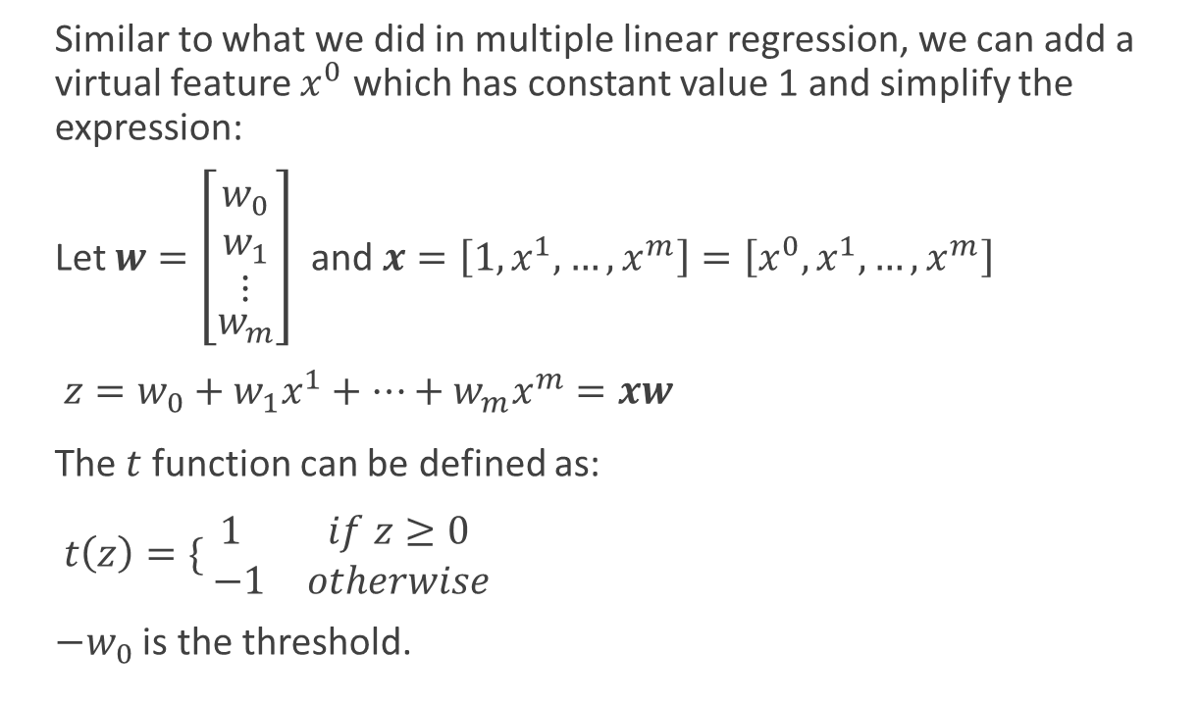
Artificial Neurons - Formal Definition
Similar to what we did in multiple linear regression, we can add a virtual feature $x^{0}$ which has constant value 1 and simplify the expression:
Let $w=\left[\begin{matrix} \\ \begin{aligned}w_{0} \\ w_{1} \\ ⋮\end{aligned} \\ w_{m}\end{matrix}\right]$ and $x=\left[1, x^{1},…,x^{m}\right]=\left[x^{0}, x^{1},…,x^{m}\right]$
$z={w_{0}+w}_{1}x^{1}+…+w_{m}x^{m}=xw$
The $t$ function can be defined as:
$t\left(z\right)=\{\begin{matrix}1 & if z≥0 \\ −1 & otherwise\end{matrix}$
$−w_{0}$ is the threshold.

Slide 9
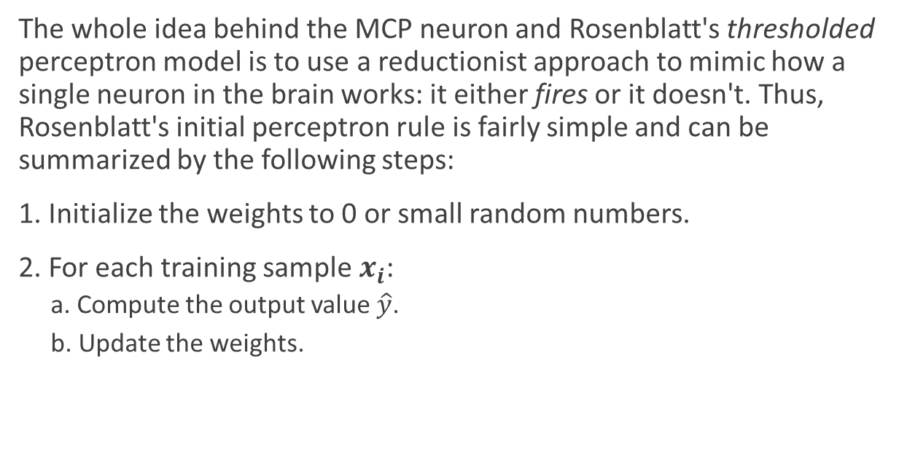
Perceptron Learning Rule
The whole idea behind the MCP neuron and Rosenblatt's thresholded perceptron model is to use a reductionist approach to mimic how a single neuron in the brain works: it either fires or it doesn't. Thus, Rosenblatt's initial perceptron rule is fairly simple and can be summarized by the following steps:
1. Initialize the weights to 0 or small random numbers.
2. For each training sample $x_{i}$:
a. Compute the output value $\hat{y}$.
b. Update the weights.

Slide 10
Artificial Neurons
1
Weight update
Error
w₀
x₁
w₁
Σ
Output
w₂
x₂
w_{m}
.
.
.
x_{m}
Schematic of a perceptron classifier.

Slide 11
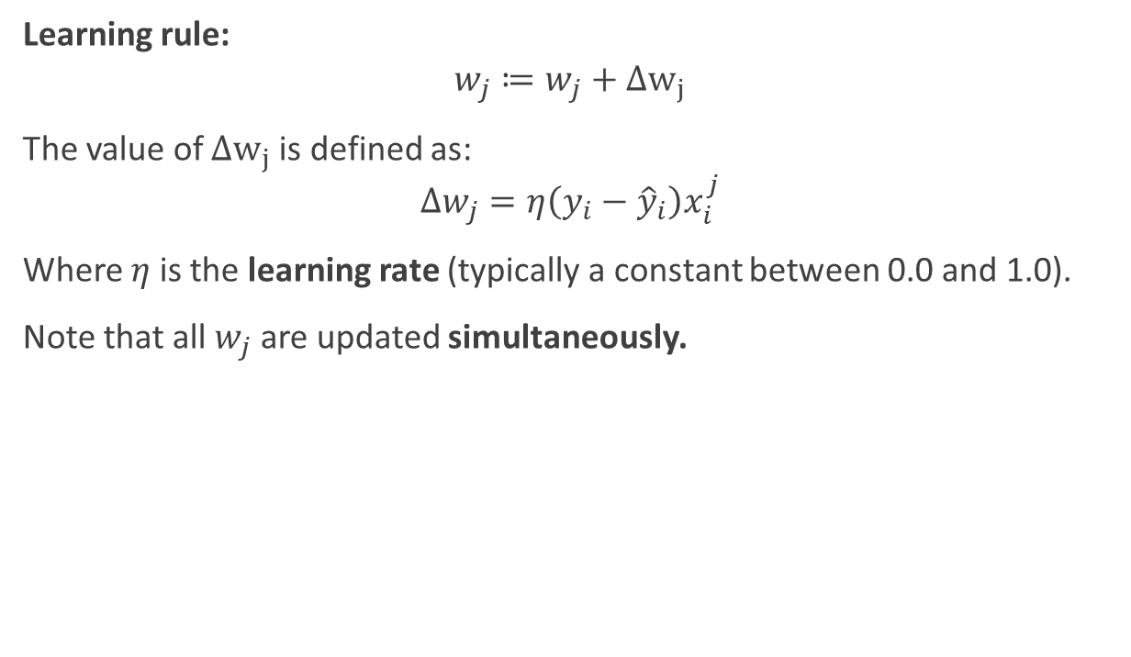
Perceptron Learning Rule
Learning rule:
$$w_{j}≔w_{j}+Δw_{j}$$
The value of $Δw_{j}$ is defined as:
$$Δw_{j}=η\left(y_{i}−{\hat{y}}_{i}\right)x_{i}^{j}$$
Where $η$ is the learning rate (typically a constant between 0.0 and 1.0).
Note that all $w_{j}$ are updated simultaneously.

Slide 12
What can be learned by perceptrons
The convergence of the perceptron is only guaranteed if the two classes are linearly separable.
Many problems are not linear separable. For example, the xor function cannot be calculated by perceptrons (proved by Minsky & Papert).

Slide 13
Linearly separable
Not linearly separable
Not linearly separable
x₂
x₂
x₂
x₁
x₁
x₁

Slide 14
Adaptive linear neurons
ADAptive LInear NEurons, also called Adaline, was invented by Bernard Widrow and his doctoral student Tedd Hoff. only a few years after Frank Rosenblatt's perceptron algorithm, and can be considered as an improvement on the latter.
The key difference between the Adaline rule (also known as the Widrow-Hoff rule) and Rosenblatt's perceptron is that the weights are updated based on a linear activation function rather than a unit step function like in the perceptron.

Slide 15
1
Weight update
Error
w₀
x₁
w₁
Σ
Output
w₂
x₂
Net input function
Threshold
function
w_{m}
.
.
.
x_{m}
1
Weight update
w₀
Error
x₁
w₁
Σ
Output
w₂
x₂
Net input function
Activation function
w_{m}
Threshold function
.
.
.
x_{m}
Adaptive Linear Neuron (Adaline)

Slide 16
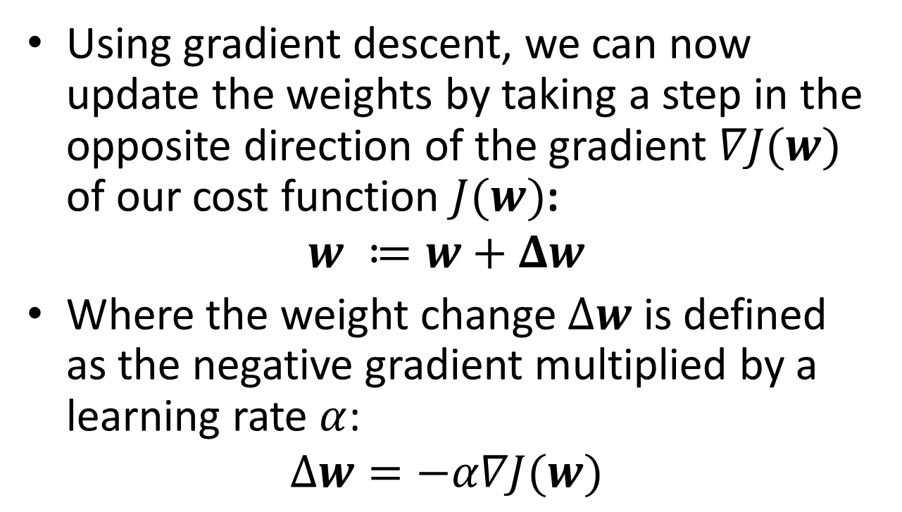
Minimizing cost functions with gradient descent
Using gradient descent, we can now update the weights by taking a step in the opposite direction of the gradient $∇J(w)$ of our cost function $J(w)$:
$$w ≔w+Δw$$
Where the weight change $Δw$ is defined as the negative gradient multiplied by a learning rate $α$:
$$Δw=−α∇J(w)$$

Slide 17

Minimizing cost functions with gradient descent
$$Δw=−α∇J\left(w\right)=\frac{α}{n}Σ_{i=1}^{n}\left(y_{i}−φ\left(z_{i}\right)\right)x_{i}^{T}$$
$$=\frac{α}{n}X^{T}(Y−φ\left(Z\right))$$

Slide 18
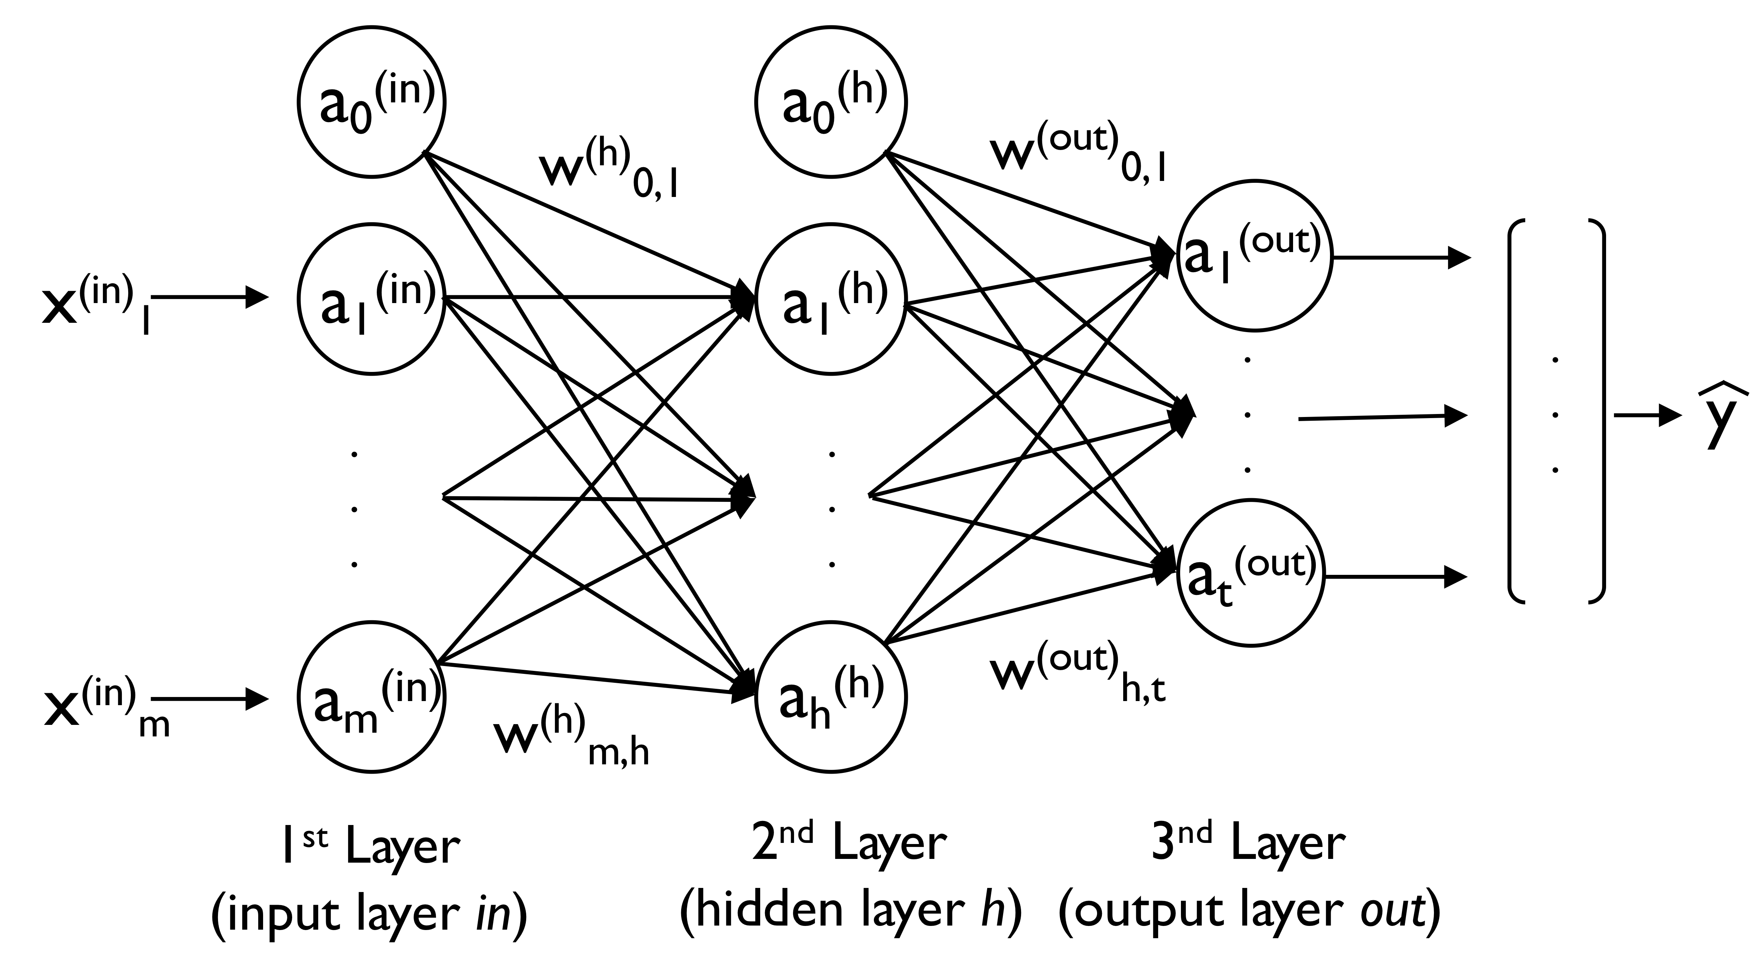
Neural Networks
Artificial neural networks we often heard are merely multiple layers of perceptrons:

Slide 19
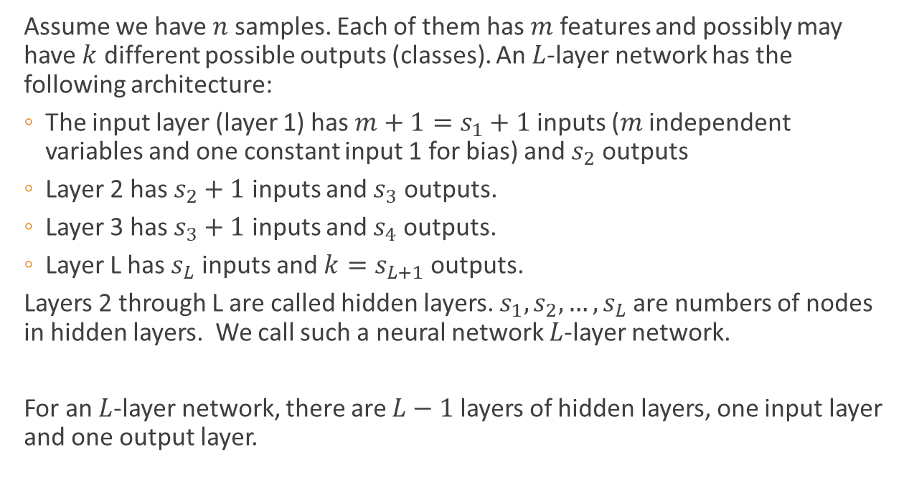
Feedfoward of Neural Network
Assume we have $n$ samples. Each of them has $m$ features and possibly may have $k$ different possible outputs (classes). An $L$-layer network has the following architecture:
The input layer (layer 1) has $m+1=s_{1}+1$ inputs ($m$ independent variables and one constant input 1 for bias) and $s_{2}$ outputs
Layer 2 has $s_{2}+1$ inputs and $s_{3}$ outputs.
Layer 3 has $s_{3}+1$ inputs and $s_{4}$ outputs.
Layer L has $s_{L}$ inputs and ${k=s}_{L+1}$ outputs.
Layers 2 through L are called hidden layers. $s_{1},s_{2},…,s_{L}$ are numbers of nodes in hidden layers. We call such a neural network $L$-layer network.
For an $L$-layer network, there are $L−1$ layers of hidden layers, one input layer and one output layer.

Slide 20
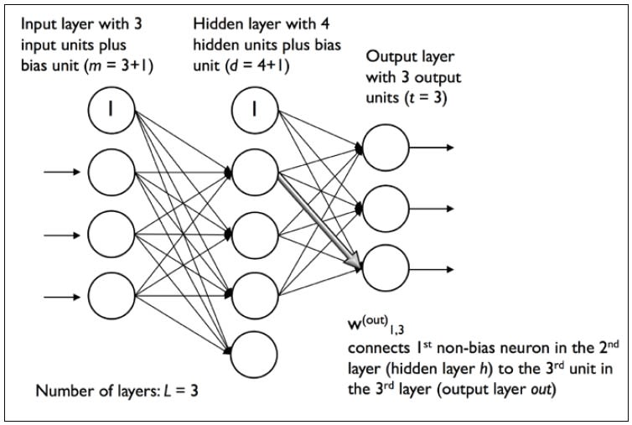
Artificial Neural Networks

Slide 21
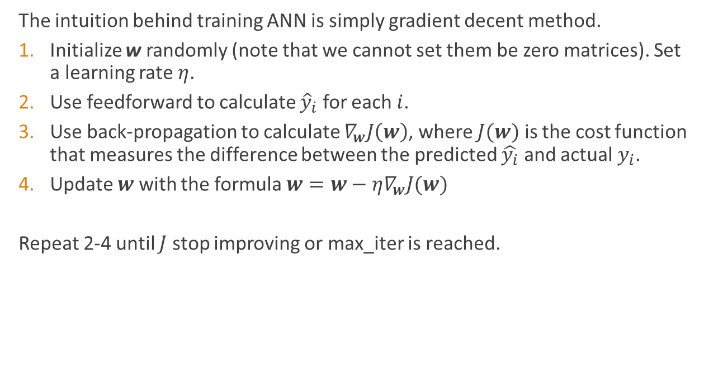
Gradient Decent for ANN
The intuition behind training ANN is simply gradient decent method.
Initialize w randomly (note that we cannot set them be zero matrices). Set a learning rate $η$.
Use feedforward to calculate ${\hat{y}}_{i}$ for each $i$.
Use back-propagation to calculate $∇_{w}J\left(w\right)$, where $J(w)$ is the cost function that measures the difference between the predicted $\hat{y_{i}}$ and actual $y_{i}$.
Update $w$ with the formula $w=w−η∇_{w}J(w)$
Repeat 2-4 until $J$ stop improving or max_iter is reached.

Slide 22
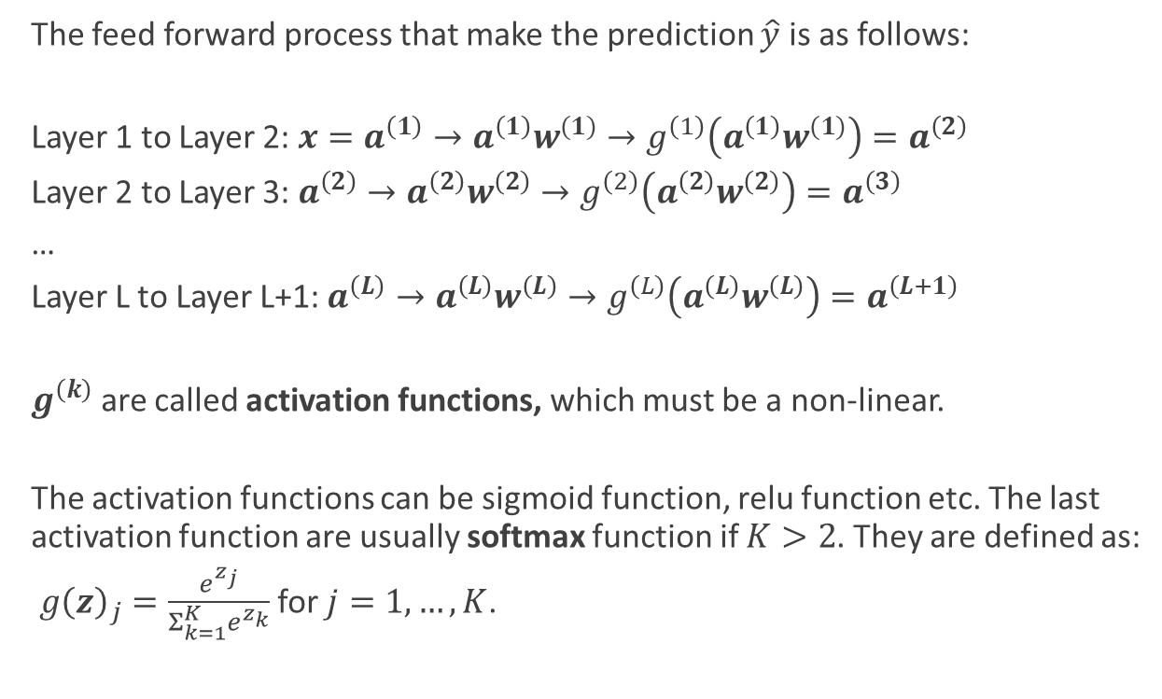
Feedfoward of Neural Network
The feed forward process that make the prediction $\hat{y}$ is as follows:
Layer 1 to Layer 2: $x=a^{\left(1\right)}→a^{\left(1\right)}w^{(1)}→g^{\left(1\right)}\left(a^{\left(1\right)}w^{(1)}\right){=a}^{\left(2\right)}$
Layer 2 to Layer 3: $a^{\left(2\right)}→a^{\left(2\right)}w^{\left(2\right)}→g^{\left(2\right)}\left(a^{\left(2\right)}w^{\left(2\right)}\right){=a}^{\left(3\right)}$
…
Layer L to Layer L+1: $a^{\left(L\right)}→a^{\left(L\right)}w^{\left(L\right)}→g^{\left(L\right)}\left(a^{\left(L\right)}w^{\left(L\right)}\right){=a}^{\left(L+1\right)}$
$g^{\left(k\right)}$ are called activation functions, which must be a non-linear.
The activation functions can be sigmoid function, relu function etc. The last activation function are usually softmax function if $K>2$. They are defined as:
$g{\left(z\right)}_{j}=\frac{e^{z_{j}}}{Σ_{k=1}^{K}e^{z_{k}}}$ for $j=1, …,K$.

Slide 23
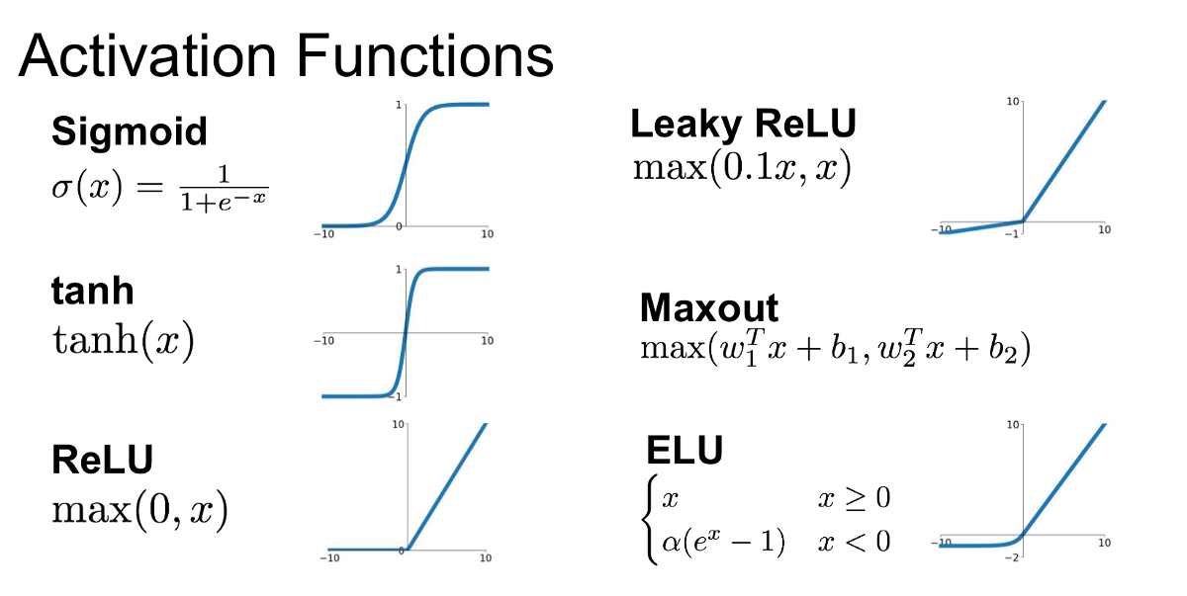
Activation Functions
Activation functions in neural networks introduce non-linearity to help the model learn complex patterns.

Slide 24
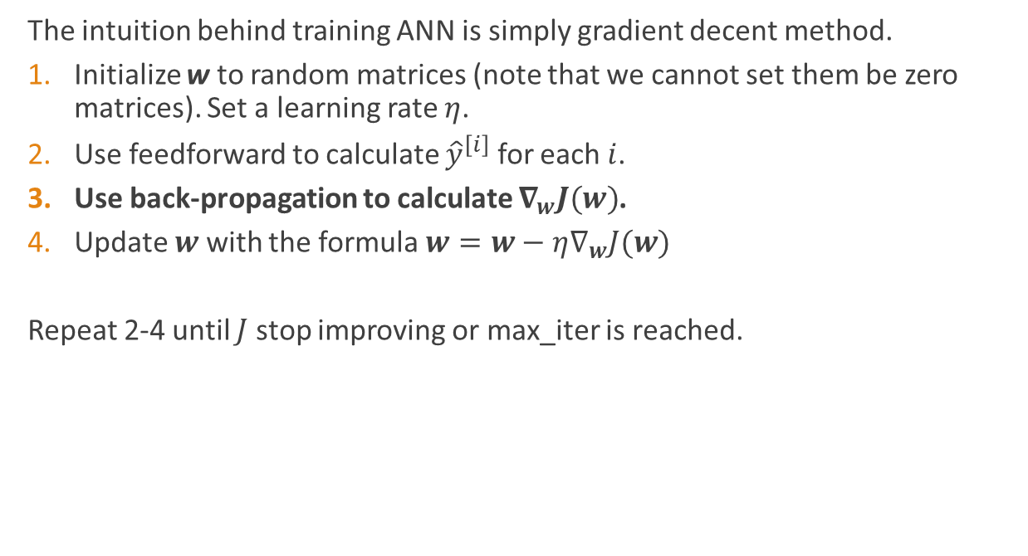
Gradient Decent for ANN
The intuition behind training ANN is simply gradient decent method.
Initialize w to random matrices (note that we cannot set them be zero matrices). Set a learning rate $η$.
Use feedforward to calculate ${\hat{y}}^{\left[i\right]}$ for each $i$.
Use back-propagation to calculate $∇_{w}J(w)$.
Update $w$ with the formula $w=w−η∇_{w}J(w)$
Repeat 2-4 until $J$ stop improving or max_iter is reached.

Slide 25
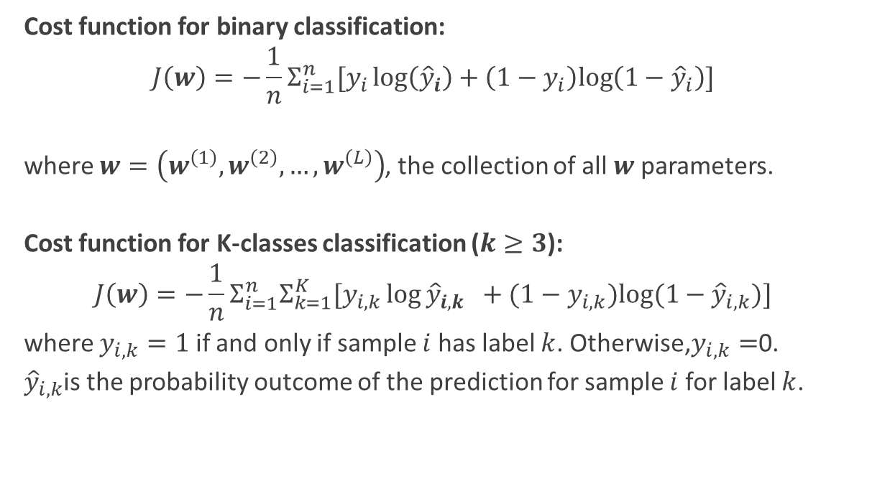
Cost Function - Cross Entropy
Cost function for binary classification:
$$J\left(w\right)=−\frac{1}{n}Σ_{i=1}^{n}[y_{i}\log\left({\hat{y}}_{i}\right)+\left(1−y_{i}\right)log\left(1−{\hat{y}}_{i}\right)]$$
where $w=\left(w^{\left(1\right)},w^{\left(2\right)},…,w^{\left(L\right)}\right)$, the collection of all $w$ parameters.
Cost function for K-classes classification ($k≥3$):
$$J\left(w\right)=−\frac{1}{n}Σ_{i=1}^{n}Σ_{k=1}^{K}[y_{i, k}\log{{\hat{y}}_{i,k} }+(1−y_{i,k})log⁡(1−{\hat{y}}_{i,k})]$$
where $y_{i,k}=1$ if and only if sample $i$ has label $k$. Otherwise,$y_{i,k}=$0.
${\hat{y}}_{i,k}$is the probability outcome of the prediction for sample $i$ for label $k$.

Slide 26
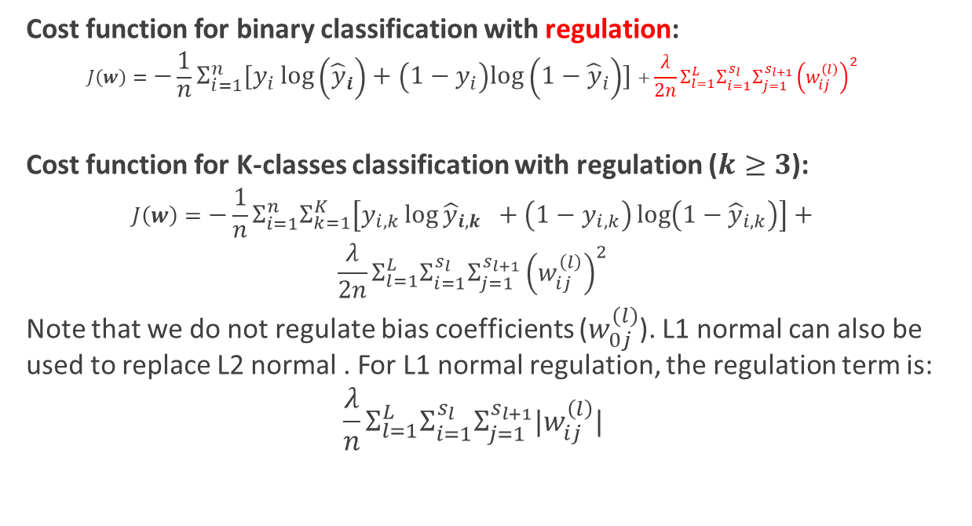
Cost Function with regulation
Cost function for binary classification with regulation:
$$J\left(w\right)=−\frac{1}{n}Σ_{i=1}^{n}[y_{i}\log\left({\hat{y}}_{i}\right)+\left(1−y_{i}\right)log\left(1−{\hat{y}}_{i}\right)]+\frac{λ}{2n}Σ_{l=1}^{L}Σ_{i=1}^{s_{l}}Σ_{j=1}^{s_{l+1}}{\left(w_{ij}^{\left(l\right)}\right)}^{2}$$
Cost function for K-classes classification with regulation ($k≥3$):
$$J\left(w\right)=−\frac{1}{n}Σ_{i=1}^{n}Σ_{k=1}^{K}\left[y_{i, k}\log{{\hat{y}}_{i,k} }+\left(1−y_{i,k}\right)\log\left(1−{\hat{y}}_{i,k}\right)\right]+$$
$$\frac{λ}{2n}Σ_{l=1}^{L}Σ_{i=1}^{s_{l}}Σ_{j=1}^{s_{l+1}}{\left(w_{ij}^{\left(l\right)}\right)}^{2}$$
Note that we do not regulate bias coefficients ($w_{0j}^{\left(l\right)}$). L1 normal can also be used to replace L2 normal . For L1 normal regulation, the regulation term is:
$$\frac{λ}{n}Σ_{l=1}^{L}Σ_{i=1}^{s_{l}}Σ_{j=1}^{s_{l+1}}|w_{ij}^{\left(l\right)}|$$

Slide 27
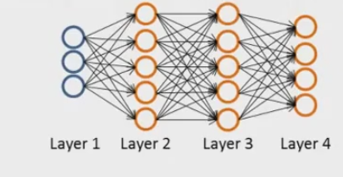


Backpropagation
Calcualte $∇_{w}J(w)$ backword:
$δ_{j}^{\left(l\right)}=$ differences at node $j$ in layer $l$
For each output unit
(we use L=3 as an example)
$δ_{j}^{\left(4\right)}=a_{j}^{\left(4\right)}−y_{j}$ for each $j$
$δ_{ }^{\left(4\right)}=a_{ }^{\left(4\right)}−y_{ }$ as vector
$δ^{\left(3\right)}={δ^{\left(4\right)}\left.w^{\left(3\right)}\right.}^{T}.∗g^{\left(3\right)}′(z^{\left(3\right)})$
$δ^{\left(2\right)}=δ^{\left(3\right)}{w^{\left(2\right)}}^{T}.∗g^{\left(2\right)}′{(z}^{\left(2\right)})$
.* is elementwise multiplication.
$$\frac{∂J\left(w\right)}{∂w_{ij}^{\left(l\right)}}=δ_{j}^{\left(l+1\right)}a_{i}^{\left(l\right)}$$

Slide 28
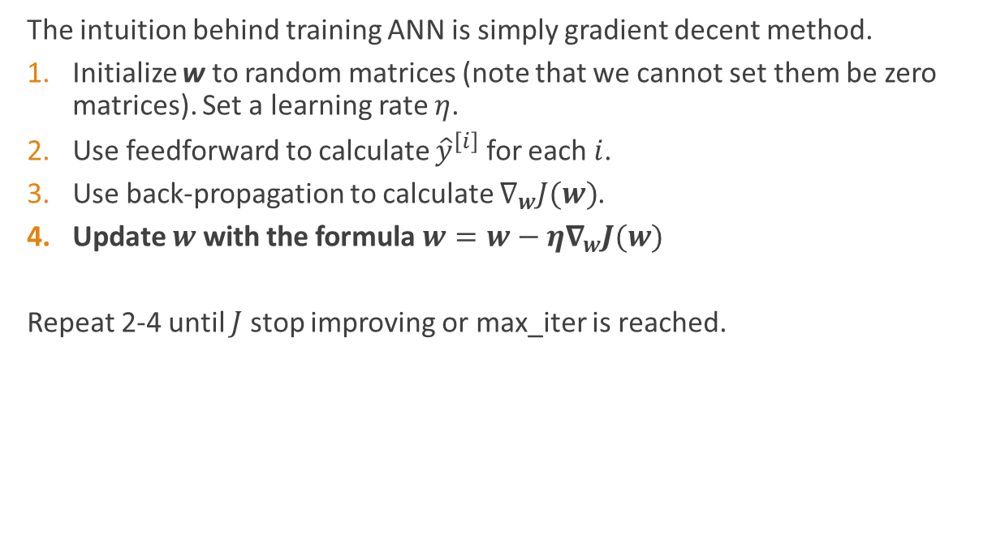
Gradient Decent for ANN
The intuition behind training ANN is simply gradient decent method.
Initialize w to random matrices (note that we cannot set them be zero matrices). Set a learning rate $η$.
Use feedforward to calculate ${\hat{y}}^{\left[i\right]}$ for each $i$.
Use back-propagation to calculate $∇_{w}J(w)$.
Update $w$ with the formula $w=w−η∇_{w}J(w)$
Repeat 2-4 until $J$ stop improving or max_iter is reached.

Slide 29
Data Preprocessing

Slide 30
Import data
Data downloaded from the Internet is usually in CSV or Excel format. Pandas provides a large set of tools including read_csv(), read_excel(), read_json(), read_html(), read_sql() etc.
The import data is stored in dataframe type, which can be considered as a matrix such that:
It is a two-dimensional mutable structure.
Data in each column must have the same data type.
Data in different columns can have different types.
Columns and rows can be labeled (named). We can use dictionary like format to access items in rows and columns.
df.values attribute return a numpy array.

Slide 31
Data Cleaning
Handling Missing Data
1. Drop missing data.
Remove rows or columns with a significant number of missing values. We can use Pandas dropna() method to do it.
2. Impute missing data.
Using mean, median, mode, or more advanced techniques like KNN imputation or interpolation.
Remove Duplicates:
Identify and remove duplicate rows to avoid data redundancy.
Handle Outliers:
Use statistical methods (e.g., IQR, Z-score) to detect and handle outliers. We can either remove, cap, or use transformations to minimize their impact.

Slide 32
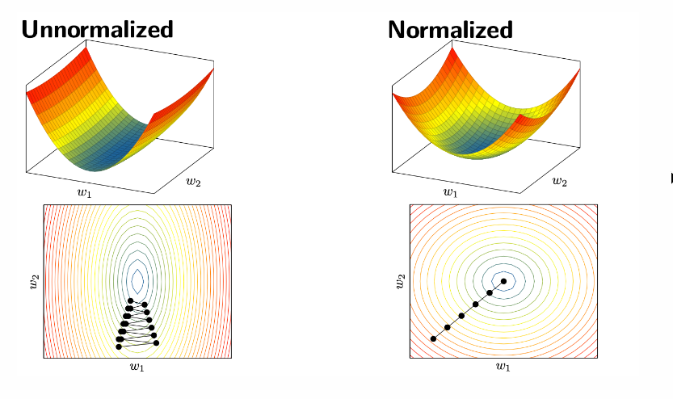
Data Transformation
Standardization (Z-score scaling): Centers data to have a mean of 0 and a standard deviation of 1. This is very useful for algorithms like, ANN SVM or logistic regression. For PCA algorithm, normalization is required.

Slide 33
Encoding Categorical Data
Very often, we will use datasets contain one or more categorical feature columns. For example, seasons, colors, education (diploma, bachelor, master, doctor etc).
A categorical data can be nominal or ordinal.
Ordinal features can be understood as categorical values that can be sorted or ordered.
For example, used car conditions: "Fair", "Good", "Excellent".
Nominal features do not imply any order:
For example: "red", "blue", "green".
Binary category:
Yes/No, True/False, Positive/Negative

Slide 34
Encoding Categorical Data
Ordinal categorical data, we can use map function to convert labels to integers:
mapping = {'poor':0, 'good':1, 'excellent':2}
df['colName']=df['colName'].map(mapping)

Slide 35
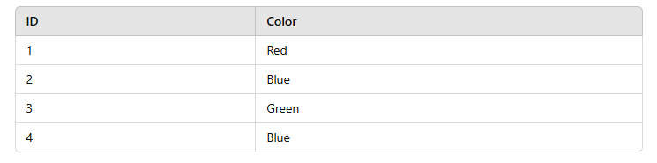
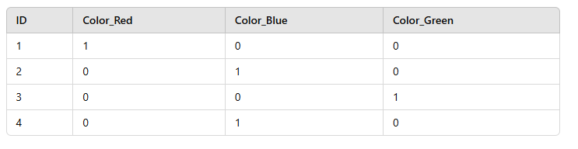
Encoding Categorical Data
Nominal data need to be encoded to one-hot encoding:
We often remove one of the one-hot columns to prevent collinearity.

Slide 36
Data Splitting
Splitting data into training set and test set
A convenient way to randomly partition this dataset into separate test and training datasets is to use the train_test_split function from scikit-learn's model_selection submodule:
X_train, X_test, y_train, y_test =\
train_test_split(X, y, test_size=0.3, random_state=0, stratify=y)
We may also need to split training data to training data and validation data

Slide 37
Hyperparameters and Validation

Slide 38
Hyperparameters
A hyperparameter is a parameter whose value is used to control the learning process. By contrast, the values of other parameters (typically node weights) are derived via training.
Examples of Hyperparameters:
Regulation strength (such as C), learning rate, topology of neural networks (number of layers, number of nodes in hidden layers), activation functions, kernel in SVM etc.
Examples of non-hyper parameters:
Weights in neural networks and perceptrons, coefficients in linear and logistic regressions.

Slide 39
Validation Set
We have learned how to use training set and test set to measure the performance of a model. We use training set to train parameters and use test set to evaluate performance. But how do we choose optimal hypterparameters?
We can further split the data set to training set, test set and validation set. A model is trained by training set with different hyperparameters. Validation set help to decide which hyperparameters shall be used. Then we use test set to measure the performance.
Training dataset: tune parameters.
Validation dataset: tune hyperparameters.
Test dataset: measure the performance of the model in real world.

Slide 40
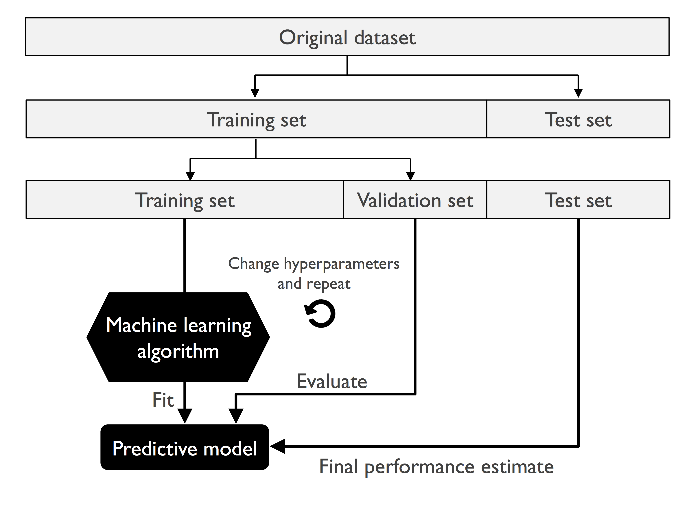
Validation Set

Slide 41
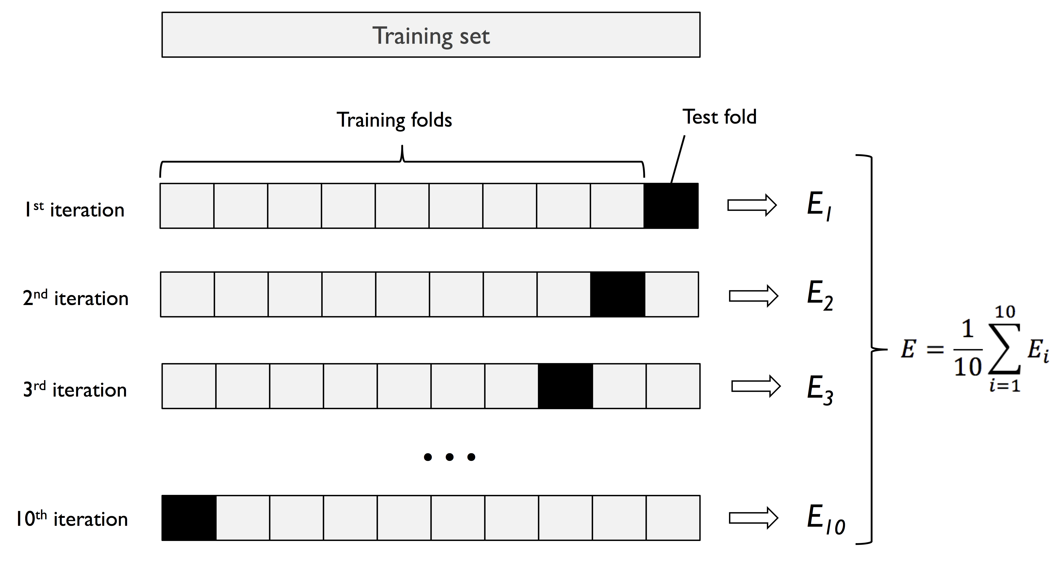
K-fold cross-validation

Slide 42
Workflow for k-fold cross validation
1. Dataset is split into training and test sets.
2. Training set is split into k subsets.
3. Training the model k rounds. In each round, k-1 sets are used as training data and the remaining set is used as test data. The average performance is the performance for the specific set of hyperparameters.
4. Find hyperparameters that give the best average performance.
5. Retrain the whole training set with hyperparemters we obtained in step 4.
6. Use the model trained in step 5 to measure the performance of test set.

Slide 43
Workflow for k-fold cross validation
Usually, large k leads to small bias because more data will be used for training. But it increases the variance and computing time.
We usually use large k for small dataset and small k for large dataset.
An extreme case for k-fold cross-validation is Leave-one-out cross-validation (LOOCV) method. In this case, k=n (the number of samples). In each fold, only 1 sample is left out for testing. This can be used for extremely small dataset.
Stratified k-fold cross-validation is a case of k-fold validation that the class proportions are preserved in each fold to ensure that each fold is representative of the class proportions in the training dataset. This is particularly useful in case of unequal class proportions.

Slide 44
Workflow for k-fold cross validation
The easiest way to run cross-validation is by using cross_val_score method in scikit-learn:
scores = cross_val_score(estimator=pipe_lr,
X=X_train,
y=y_train,
cv=10,
n_jobs=1)

